Slide 1

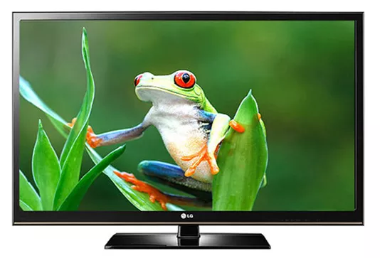
Image and Image File Formats

Slide 2
Picture format
In the so-called raw format, the file contains only the gray values of the pixels.
Bits/picture = Rows x Columns x bits/pixel
Bytes/picture = Rows x Columns x bytes/pixel
Example (the next slide ):
256 rows, 256 columns, 1 byte per pixel.
Bytes = 256 x 256 x 1 = 65536
The quality largely depends on its resolution

Slide 3

Picture format
1 | 2 | 3 | ... | 256
257 | 258 | 259 | ... | 512
513 | 514 | 515 | ... | 768
... | ... | ... | ... | ...
65,280 | 65,281 | ... | ... | 65,536

Slide 4

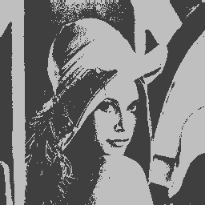



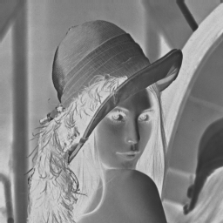
Picture format
256x256, 4 bit, 32 kB
256x256, 1 bit, 8 kB
256x256, 4 bit, 32 kB
256x256, 2 bit, 32 kB
128x128, 4 bit, 16 kB
256x256, 8 bit, 65 kB

Slide 5
Picture format
Color is represented on a computer by using varying amounts of red, green and blue light
These are the primary colors of what's called "additive" color - by adding percentages of red, green and blue, any color can be created
In the simplest sort of bitmapped image, each pixel is represented by three numbers to store the amounts of red, green and blue light that define the color of the pixel in question

Slide 6
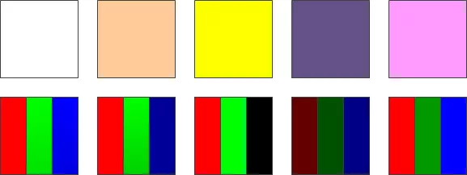
Picture format
The different color intensities can be used to make different colors

Slide 7
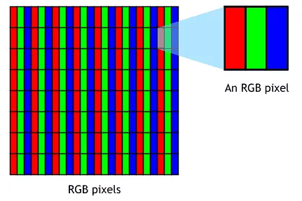
Pixel
Short for Picture Element, a pixel is a single point in a graphic image
The word "pixel" was first published in 1965 by Frederic C. Billingsley
The word pix appeared in Variety magazine in 1932

Slide 8
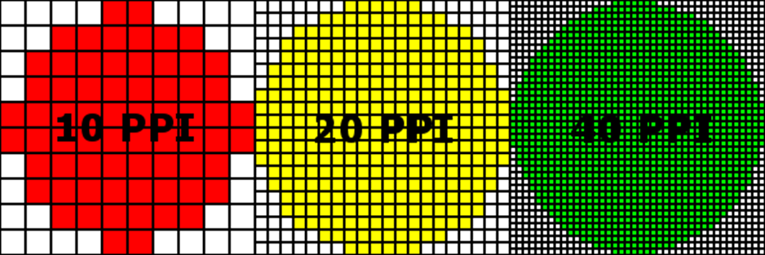
Pixel (BPP)
The number of bits used to represent each pixel determines how many colors or shades of gray can be displayed.
1 bpp, 2¹ = 2 colors (monochrome)
2 bpp, 2² = 4 colors
3 bpp, 2³ = 8 colors
...
8 bpp, 2⁸ = 256 colors
16 bpp, 2¹⁶ = 65,536 colors ("Highcolor" )
24 bpp, 2²⁴ = 16,777,216 colors ("Truecolor")

Slide 9



Pixel geometry
On color monitors, each pixel is actually composed of three dots -- a red, a blue, and a green one. Ideally, the three dots should all converge at the same point, but all monitors have some convergence error that can make color pixels appear fuzzy.

Slide 10
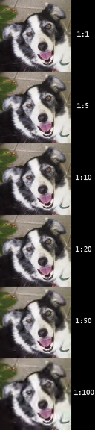
JPEG
Joint Photographic Experts Group
The most used image file format
JPEG applies lossy compression to images, which can result in a significant reduction of the file size
JPEG 2000 is enabling both lossless and lossy storage

Slide 11
JPEG
Works very badly on text, line art or other types of mechanical graphics
Does not support transparency or multiple images
Cannot be used for animation
Ideal for photographic, paintings

Slide 12
TIFF
Tagged Image File Format
TIF is lossless which is considered the highest quality format for commercial work
Normally saves eight bits or sixteen bits per color (red, green, blue) for 24-bit and 48-bit totals
Can be lossy or lossless
Not supported by web browsers
The most versatile: widely accepted as a photograph file standard in the printing business

Slide 13
GIF
Graphics Interchange Format
GIF was designed by CompuServe in the early days of computer 8-bit video, before JPG
LZW (Lempel-Zev-Welch) compression
Normal use limited to an 8-bit palette, or 256 colors
Most suitable for storing graphics with few colors, such as simple diagrams, shapes, logos, and cartoon style images

Slide 14

PNG
Portable Network Graphics
Was created as an improved, non-patented replacement for GIF
Additional feature of PNG is transparency for 24 bit RGB images
PNG files are a little smaller than LZW compression in TIF or GIF
Slower to read or write
Not support by old browsers

Slide 15
Difference in photo and graphics images
Photo images have continuous tones
Adjacent pixels often have very similar colors
Normally this is 24-bit RGB color, or 8-bit grayscale
A typical color photo may contain a hundred thousand RGB colors, out of 16 million colors in 24-bit RGB color
Graphic images are not continuous tone
Are drawings, not photos
They use few colors, often less than 16 colors in the entire image

